Slide 1
Parallel Computing
Ekkapot Charoenwanit
Software Systems Engineering
TGGS
KMUTNB

Slide 2
Lecture 1: Parallel Performance Analysis

Slide 3
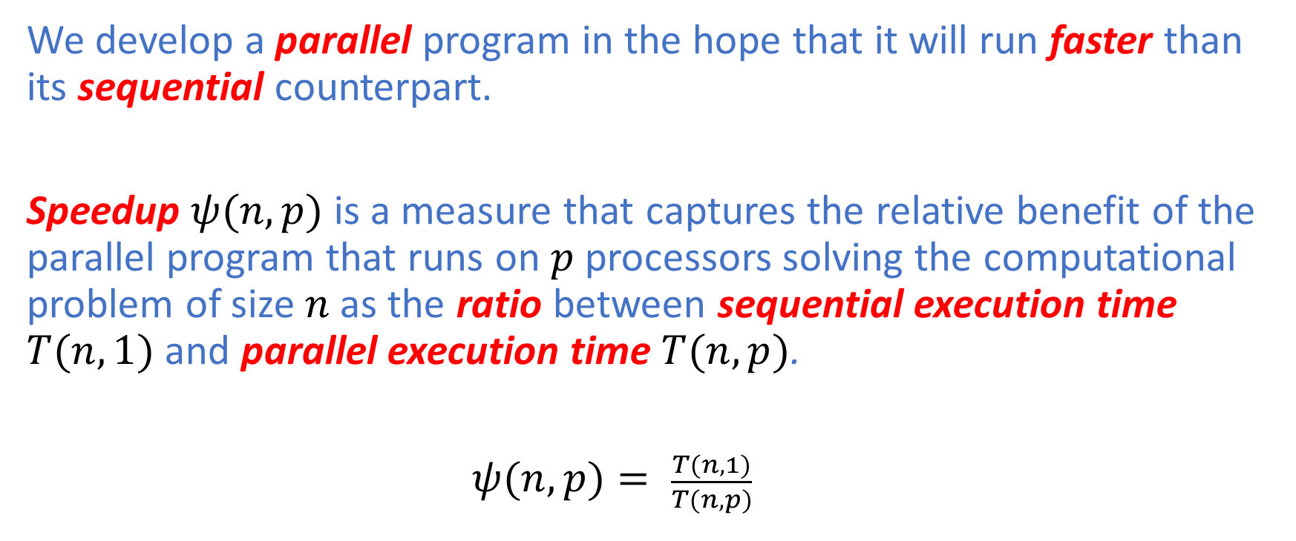
Performance Analysis: Speedup
We develop a parallel program in the hope that it will run faster than its sequential counterpart.
Speedup $ψ(n,p)$ is a measure that captures the relative benefit of the parallel program that runs on $p$processors solving the computational problem of size $n$as the ratio between sequential execution time $T(n,1)$and parallel execution time $T(n,p)$.
$ψ(n,p)= \frac{T(n,1)}{T(n,p)}$

Slide 4
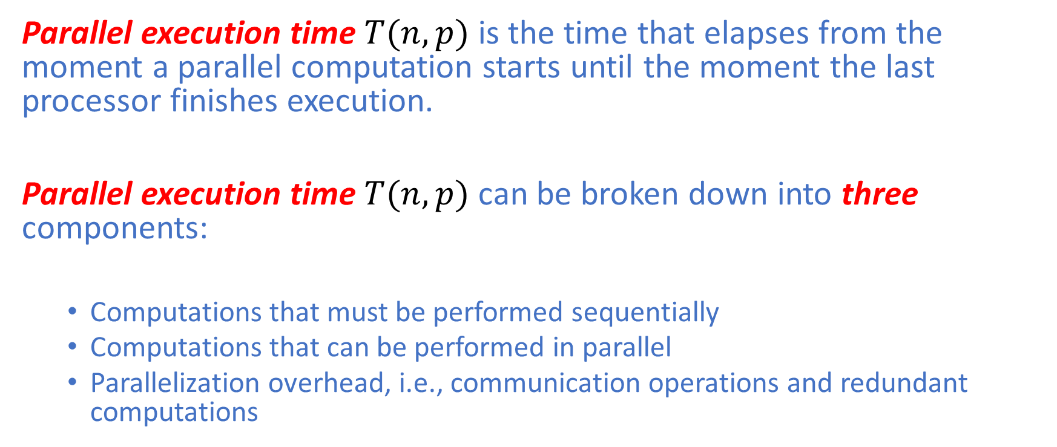
Performance Analysis: Parallel Execution Time
Parallel execution time $T(n,p)$ is the time that elapses from the moment a parallel computation starts until the moment the last processor finishes execution.
Parallel execution time $T(n,p)$ can be broken down into three components:
Computations that must be performed sequentially
Computations that can be performed in parallel
Parallelization overhead, i.e., communication operations and redundant computations

Slide 5
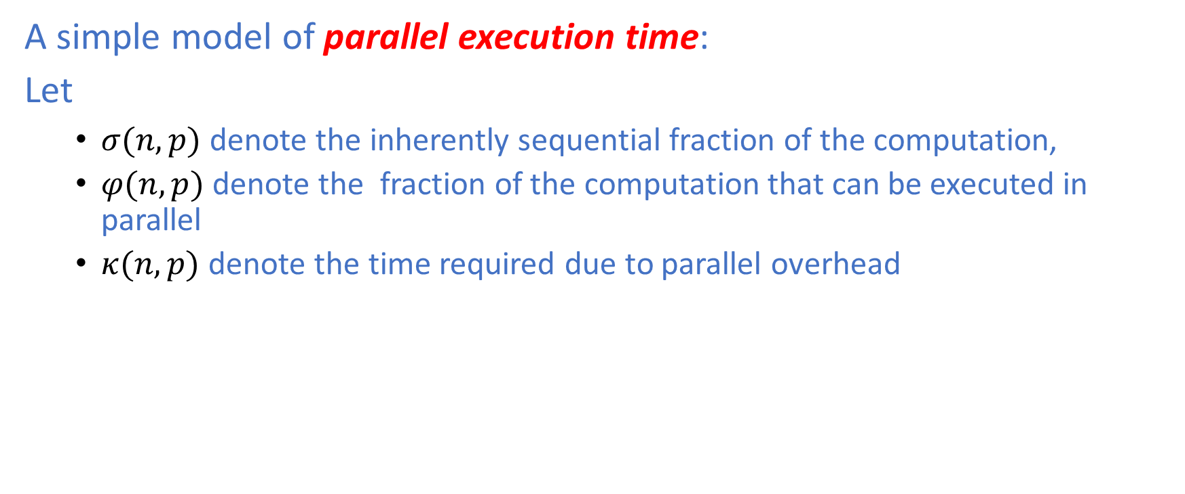
Performance Analysis: Parallel Execution Time
A simple model of parallel execution time:
Let
$σ(n,p)$ denote the inherently sequential fraction of the computation,
$φ(n,p)$ denote the fraction of the computation that can be executed in parallel
$κ(n,p)$ denote the time required due to parallel overhead

Slide 6
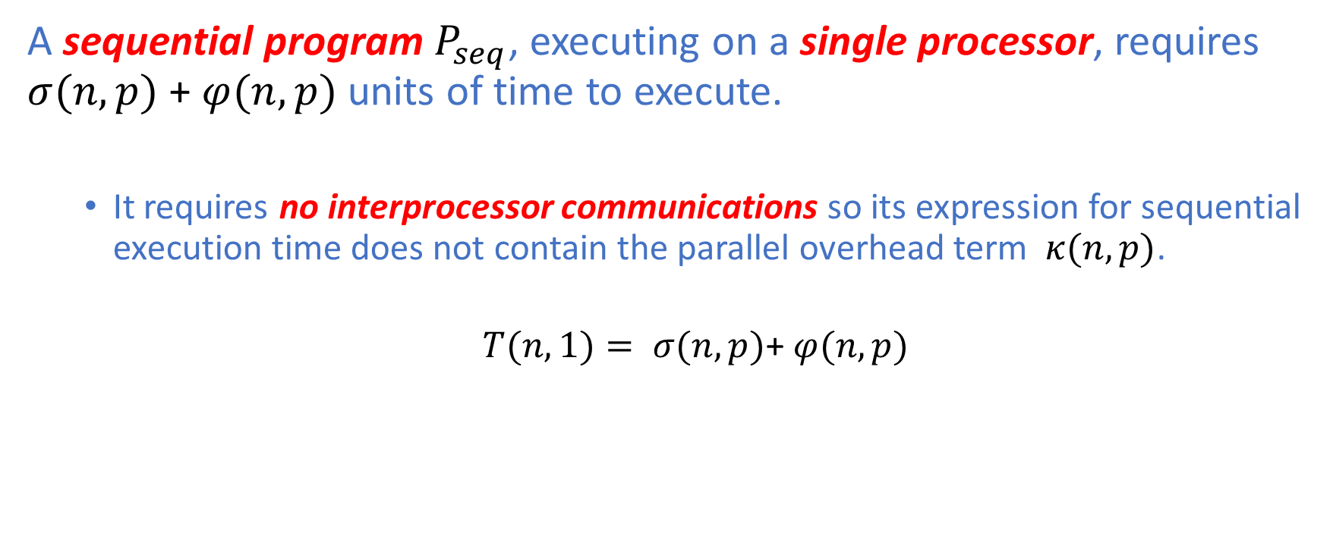
Performance Analysis: Parallel Execution Time
A sequential program $P_{seq}$, executing on a single processor, requires $σ(n,p)$ + $φ(n,p)$ units of time to execute.
It requires no interprocessor communications so its expression for sequential execution time does not contain the parallel overhead term $κ(n,p)$.
$T(n,1)= σ(n,p)$+ $φ(n,p)$

Slide 7
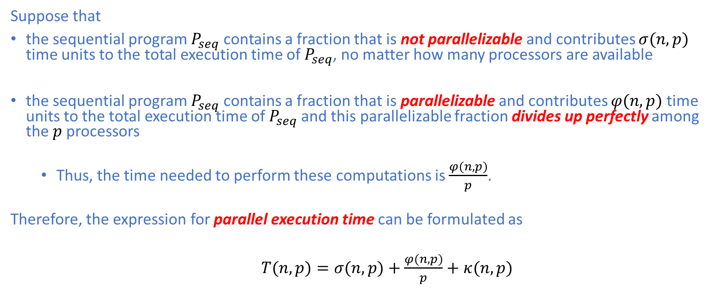
Performance Analysis: Parallel Execution Time
Suppose that
the sequential program $P_{seq}$ contains a fraction that is not parallelizable and contributes $σ(n,p)$ time units to the total execution time of $P_{seq}$, no matter how many processors are available
the sequential program $P_{seq}$ contains a fraction that is parallelizable and contributes $φ(n,p)$ time units to the total execution time of $P_{seq}$and this parallelizable fraction divides up perfectly among the $p$processors
Thus, the time needed to perform these computations is $\frac{φ(n,p)}{p}$.
Therefore, the expression for parallel execution time can be formulated as
$T(n,p)=σ(n,p)+\frac{φ(n,p)}{p}+$ $κ(n,p)$

Slide 8
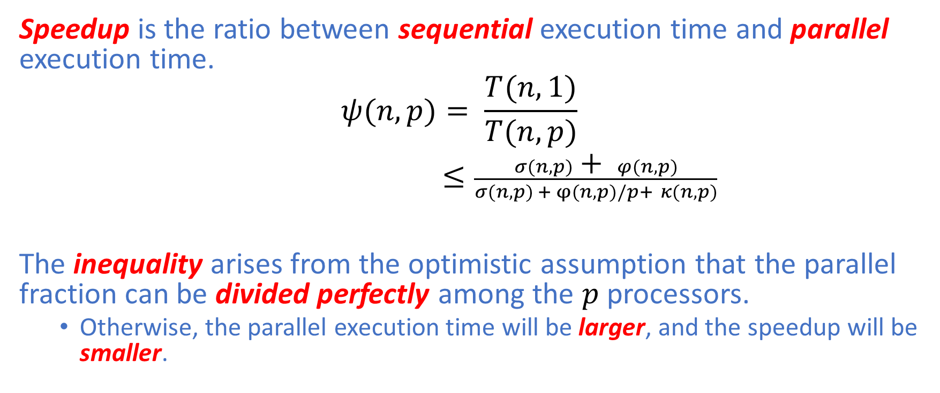
Performance Analysis: U-Bound on Speedup
Speedup is the ratio between sequential execution time and parallel execution time.
$$ψ(n,p)= \frac{T(n,1)}{T(n,p)}$$
$≤\frac{σ(n,p)\text{ +} φ(n,p)}{σ(n,p) + φ(n,p)/p+ κ(n,p)}$
The inequality arises from the optimistic assumption that the parallel fraction can be divided perfectly among the $p$ processors.
Otherwise, the parallel execution time will be larger, and the speedup will be smaller.

Slide 9
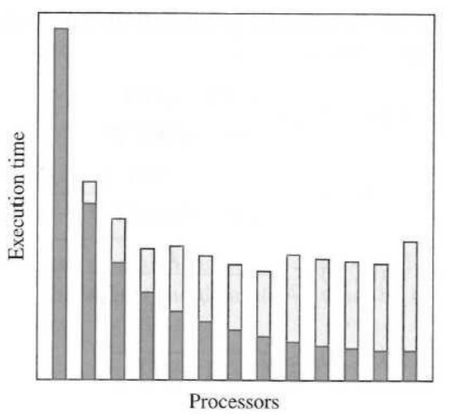
Performance Analysis: Parallel Overhead
Adding more processors reduces the computation time by dividing the work among more processors, but increases the communication time.
At some point, the increase in communication time is larger than the decrease in computation time.
At this point, the parallel execution time begins to increase.
The figure on the right demonstrates that a non-trivial parallel algorithm has a computation component (black bars) that is a decreasing function of the number of processors and a communication component (gray bars) that is an increasing function of the number of processors.

Slide 10
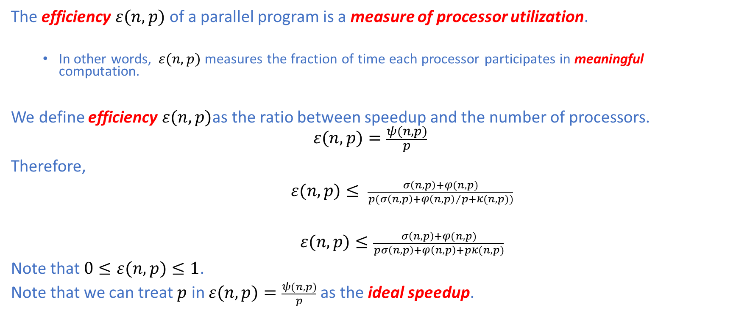
Performance Analysis: Efficiency
The efficiency $ε(n,p)$of a parallel program is a measure of processor utilization.
In other words, $ε(n,p)$ measures the fraction of time each processor participates in meaningful computation.
We define efficiency $ε(n,p)$as the ratio between speedup and the number of processors.
$$ε(n,p)=\frac{ψ(n,p)}{p}$$
Therefore,
$ε(n,p)≤ \frac{σ\left(n,p\right)+φ(n,p)}{p(σ\left(n,p\right)+{φ\left(n,p\right)}/p+κ(n,p))}$
$ε(n,p)≤\frac{σ\left(n,p\right)+φ(n,p)}{pσ\left(n,p\right)+φ\left(n,p\right)+pκ(n,p)}$
Note that $0≤ε(n,p)≤1$.
Note that we can treat $p$ in $ε(n,p)=\frac{ψ(n,p)}{p}$as the ideal speedup.

Slide 11
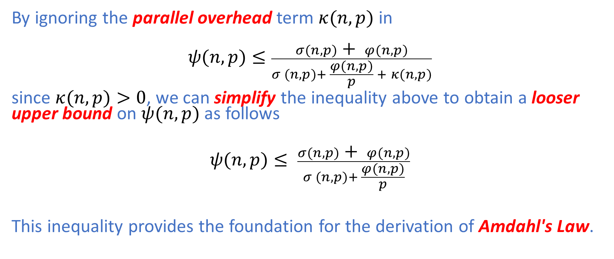
Performance Analysis: Amdahl's Law
By ignoring the parallel overhead term $κ(n,p)$ in
$$ψ(n,p)≤\frac{σ(n,p) \text{+} φ(n,p)}{σ (n,p)+ \frac{φ(n,p)}{p} + κ(n,p)}$$
since $κ(n,p)>0$, we can simplify the inequality above to obtain a looser upper bound on $ψ(n,p)$as follows
$$ψ(n,p)≤ \frac{σ(n,p)\text{ +} φ(n,p)}{σ (n,p)+ \frac{φ(n,p)}{p}}$$
This inequality provides the foundation for the derivation of Amdahl's Law.

Slide 12
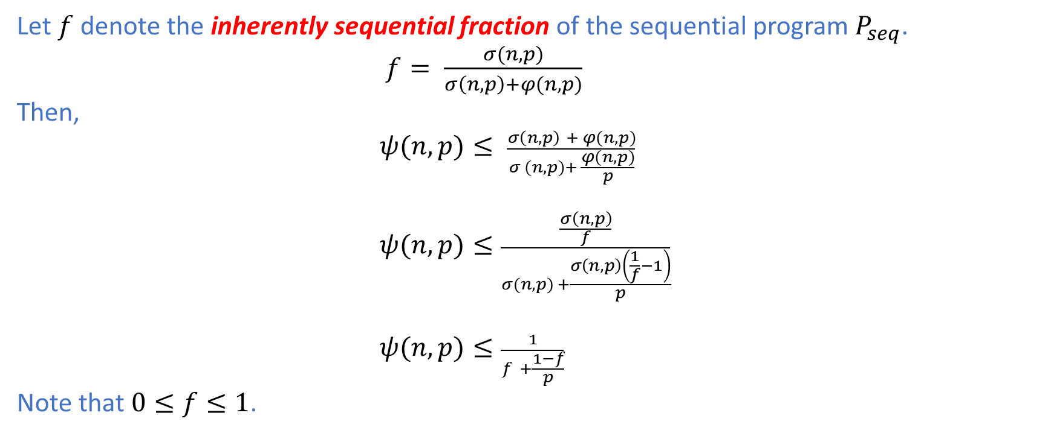
Performance Analysis: Amdahl's Law
Let $f$ denote the inherently sequential fraction of the sequential program $P_{seq}$.
$f= \frac{σ(n,p)}{σ\left(n,p\right)+φ(n,p)}$
Then,
$ψ(n,p)≤ \frac{σ\left(n,p\right) + φ(n,p)}{σ (n,p)+ \frac{φ(n,p)}{p}}$
$ψ(n,p)≤\frac{\frac{σ\left(n,p\right)}{f}}{σ(n,p) +\frac{σ\left(n,p\right)\left(\frac{1}{f}−1\right)}{p}}$
$ψ(n,p)≤\frac{1}{f +\frac{1−f}{p}}$
Note that $0≤f≤1$.

Slide 13
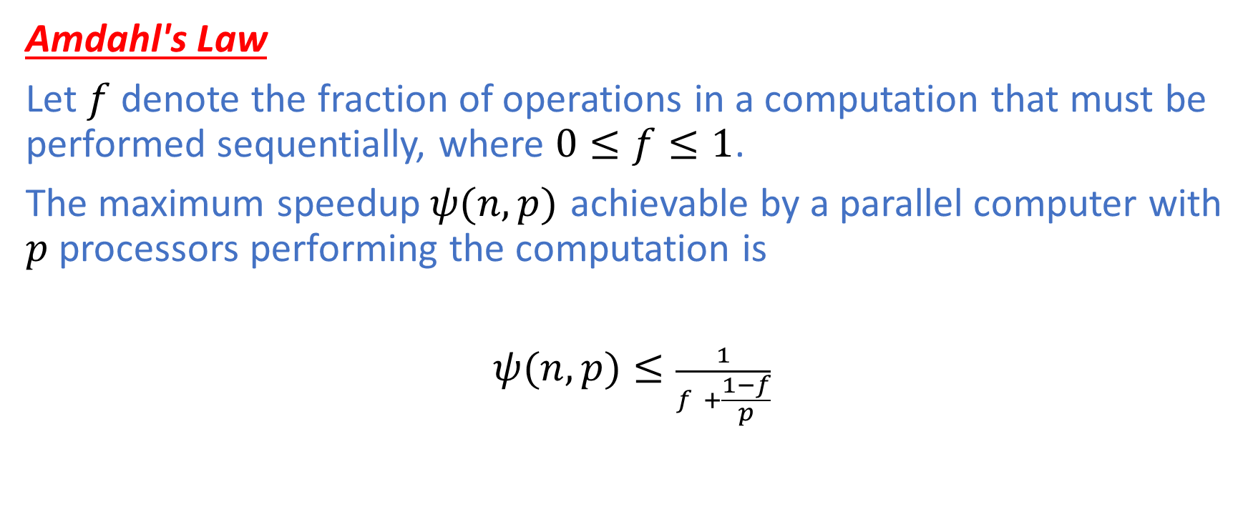
Performance Analysis: Amdahl's Law
Amdahl's Law
Let $f$ denote the fraction of operations in a computation that must be performed sequentially, where $0≤f≤1$.
The maximum speedup$ψ(n,p)$ achievable by a parallel computer with $p$ processors performing the computation is
$ψ(n,p)≤\frac{1}{f +\frac{1−f}{p}}$

Slide 14
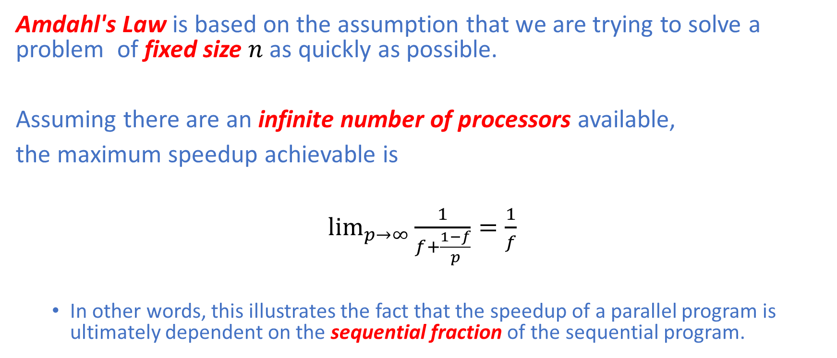
Performance Analysis: Amdahl's Law
Amdahl's Law is based on the assumption that we are trying to solve a problem of fixed size $n$ as quickly as possible.
Assuming there are an infinite number of processors available,
the maximum speedup achievable is
$\lim_{p→∞}{\frac{1}{f+\frac{1−f}{p}}=\frac{1}{f}}$
In other words, this illustrates the fact that the speedup of a parallel program is ultimately dependent on the sequential fraction of the sequential program.

Slide 15
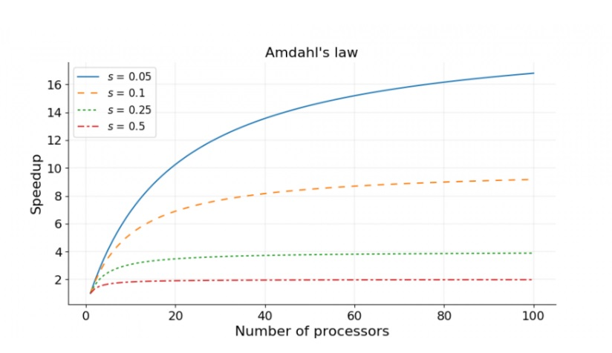

Performance Analysis: Amdahl's Law
The figure on the right illustrates the maximum speedup of a parallel program with different values of $f$. The ideal speedup is represented by a straight line with a slope of $1$ that passes through the origin.

Slide 16
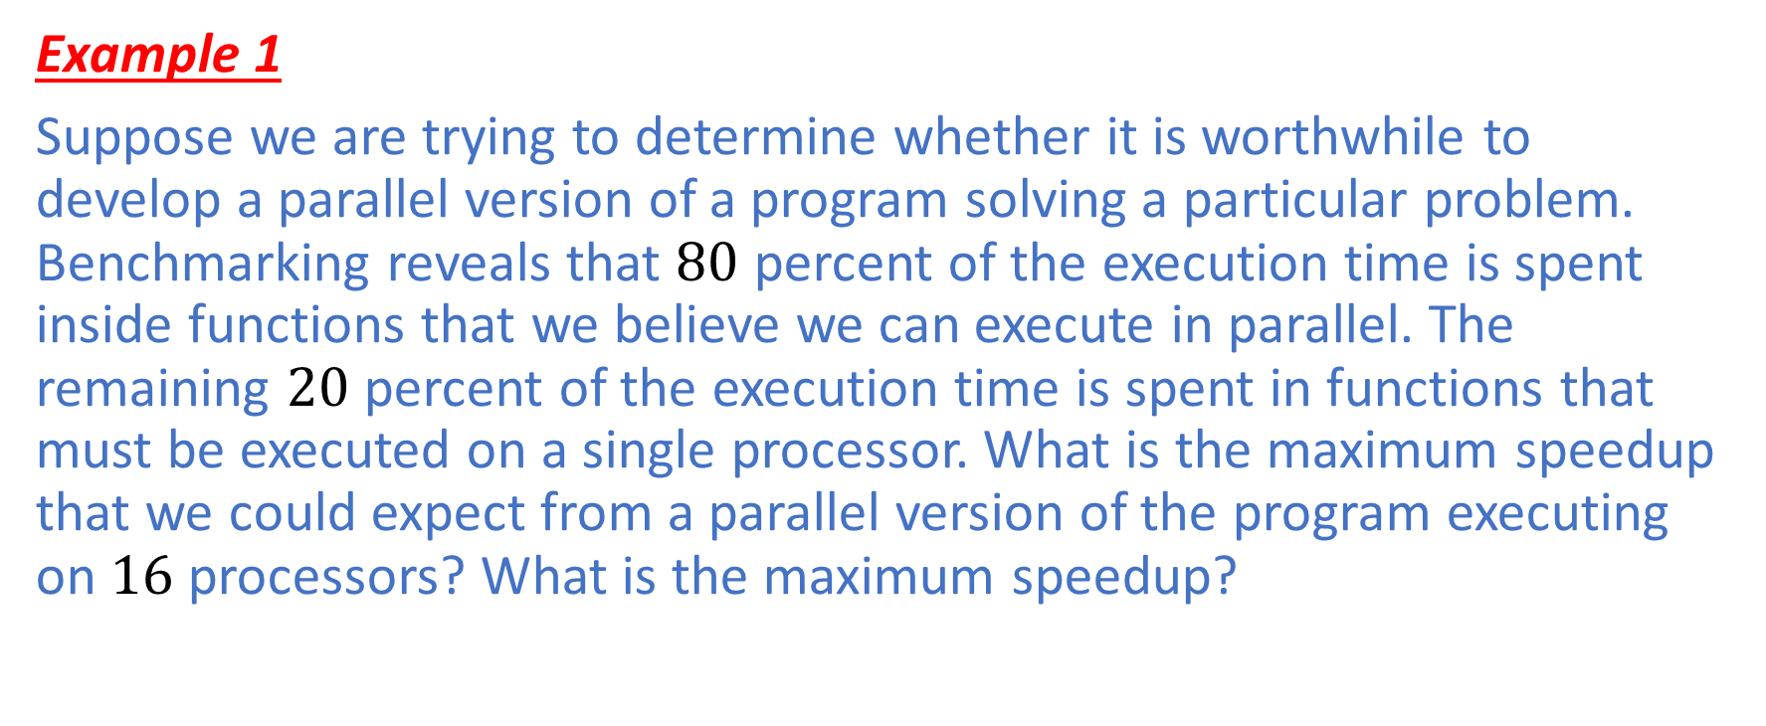
Performance Analysis: Amdahl's Law
Example 1
Suppose we are trying to determine whether it is worthwhile to develop a parallel version of a program solving a particular problem. Benchmarking reveals that $80$ percent of the execution time is spent inside functions that we believe we can execute in parallel. The remaining $20$ percent of the execution time is spent in functions that must be executed on a single processor. What is the maximum speedup that we could expect from a parallel version of the program executing on $16$ processors? What is the maximum speedup?

Slide 17
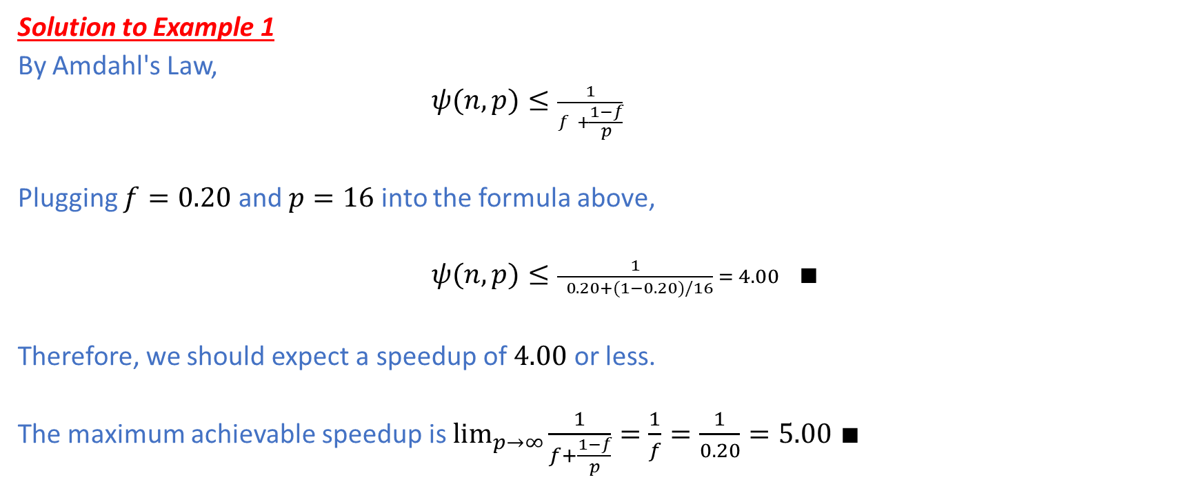
Performance Analysis: Amdahl's Law
Solution to Example 1
By Amdahl's Law,
$ψ(n,p)≤\frac{1}{f +\frac{1−f}{p}}$
Plugging $f=0.20$ and $p=16$ into the formula above,
$ψ(n,p)≤\frac{1}{ 0.20+(1−0.20)/16} = 4.00$ $∎$
Therefore, we should expect a speedup of $4.00$ or less.
The maximum achievable speedup is $\lim_{p→∞}{\frac{1}{f+\frac{1−f}{p}}=\frac{1}{f}=\frac{1}{0.20}=5.00}$ $∎$

Slide 18
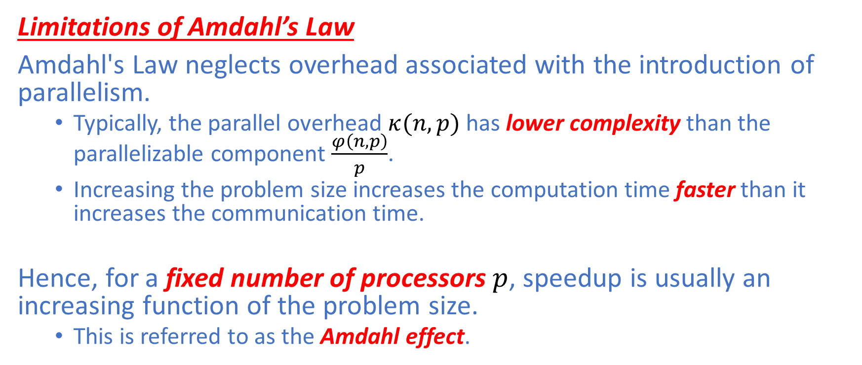
Performance Analysis: Amdahl Effect
Limitations of Amdahl’s Law
Amdahl's Law neglects overhead associated with the introduction of parallelism.
Typically, the parallel overhead $κ(n,p)$ has lower complexity than the parallelizable component $\frac{φ\left(n,p\right)}{p}$.
Increasing the problem size increases the computation time faster than it increases the communication time.
Hence, for a fixed number of processors $p$, speedup is usually an increasing function of the problem size.
This is referred to as the Amdahl effect.

Slide 19
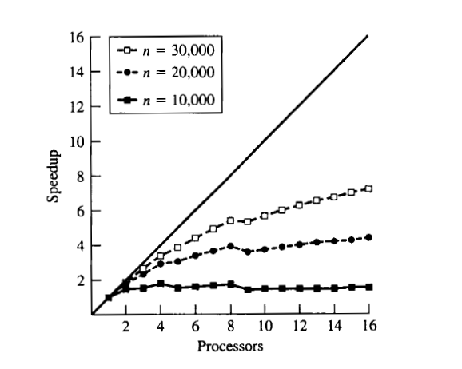

Performance Analysis: Amdahl Effect
Limitations of Amdahl's Law
For any fixed number of processors, speedup is usually an increasing function of the problem size.
This is called the Amdahl effect.
Amdahl's Law assumes a fixed problem size $n$ so it can underestimate speedup for large problem sizes.

Slide 20
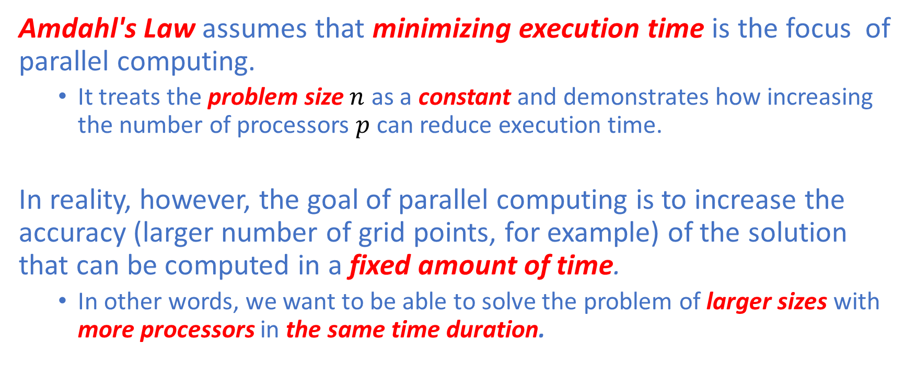
Performance Analysis: Gustafson’s Law
Amdahl's Law assumes that minimizing execution time is the focus of parallel computing.
It treats the problem size $n$ as a constant and demonstrates how increasing the number of processors $p$ can reduce execution time.
In reality, however, the goal of parallel computing is to increase the accuracy (larger number of grid points, for example) of the solution that can be computed in a fixed amount of time.
In other words, we want to be able to solve the problem of larger sizes with more processors in the same time duration.

Slide 21
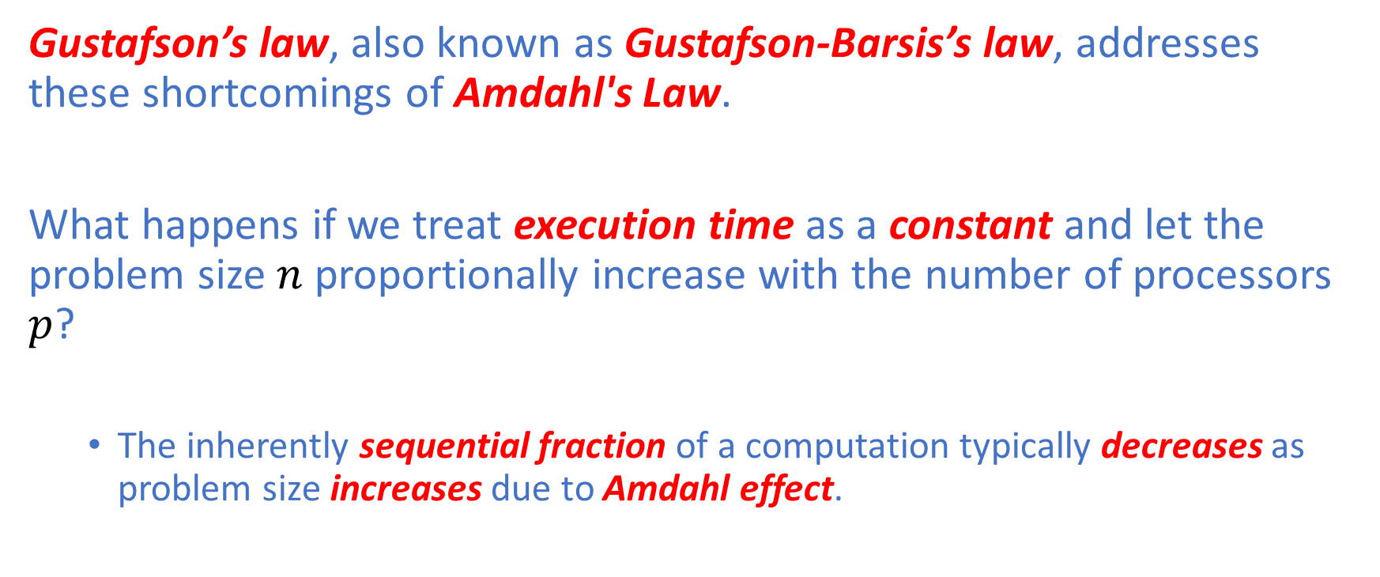
Performance Analysis: Gustafson’s Law
Gustafson’s law, also known as Gustafson-Barsis’s law, addresses these shortcomings of Amdahl's Law.
What happens if we treat execution time as a constant and let the problem size $n$ proportionally increase with the number of processors $p$?
The inherently sequential fraction of a computation typically decreases as problem size increases due to Amdahl effect.

Slide 22
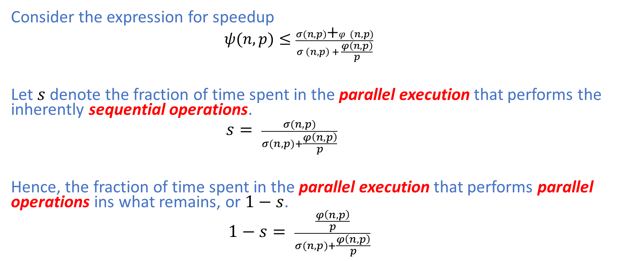
Performance Analysis: Gustafson’s Law
Consider the expression for speedup
$ψ(n,p)≤\frac{σ(n,p)\text{+}φ(n,p)}{σ \left(n,p\right) + \frac{φ\left(n,p\right)}{p}}$
Let $s$ denote the fraction of time spent in the parallel execution that performs the inherently sequential operations.
$s= \frac{σ(n,p)}{σ(n,p)+\frac{φ\left(n,p\right)}{p}}$
Hence, the fraction of time spent in the parallel execution that performs parallel operations ins what remains, or $1−s$.
$1−s= \frac{\frac{φ\left(n,p\right)}{p}}{σ(n,p)+\frac{φ\left(n,p\right)}{p}}$

Slide 23
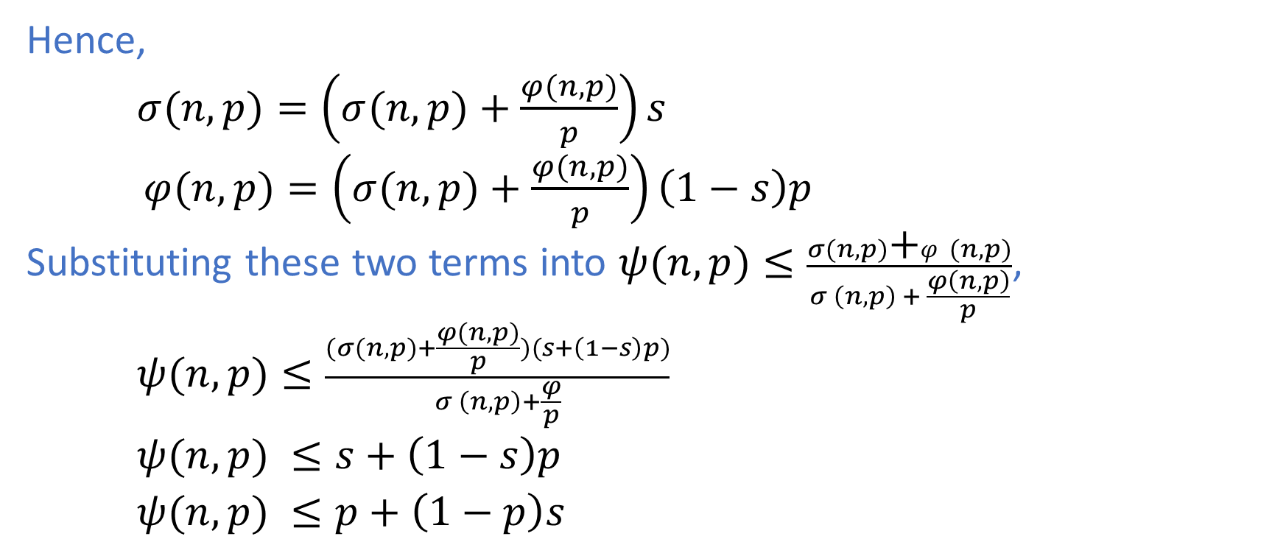
Performance Analysis: Gustafson’s Law
Hence,
$σ(n,p)=\left(σ(n,p)+\frac{φ(n,p)}{p}\right)s$
$φ(n,p)=\left(σ(n,p)+\frac{φ(n,p)}{p}\right)\left(1−s\right)p$
Substituting these two terms into $ψ(n,p)≤\frac{σ(n,p)\text{+}φ(n,p)}{σ \left(n,p\right) + \frac{φ\left(n,p\right)}{p}}$,
$ψ(n,p)≤\frac{(σ(n,p)+\frac{φ(n,p)}{p})(s+\left(1−s\right)p)}{σ \left(n,p\right)+\frac{φ}{p}}$
$ψ(n,p) ≤s+\left(1−s\right)p$
$ψ(n,p) ≤p+\left(1−p\right)s$

Slide 24
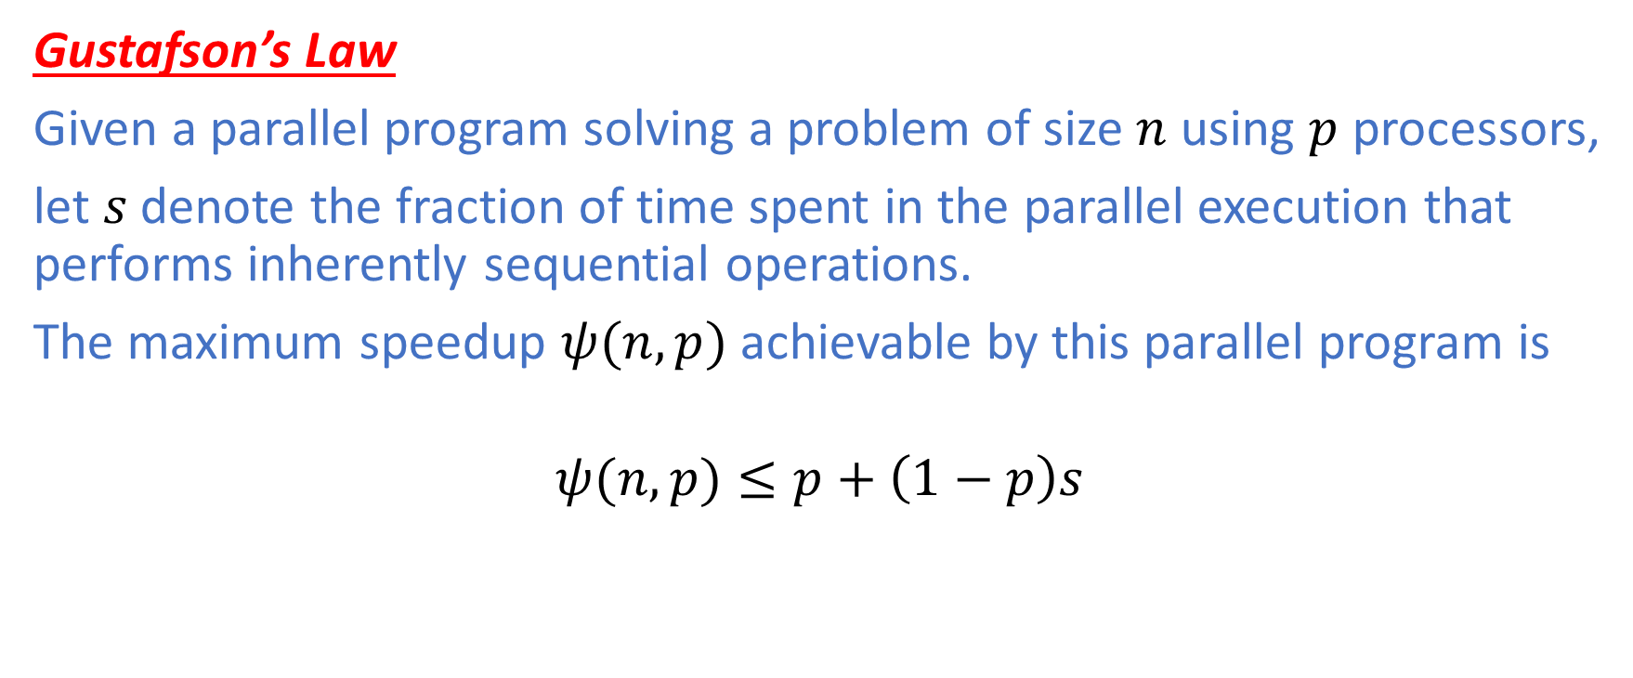
Performance Analysis: Gustafson’s Law
Gustafson’s Law
Given a parallel program solving a problem of size $n$ using $p$ processors,
let $s$ denote the fraction of time spent in the parallel execution that performs inherently sequential operations.
The maximum speedup $ψ(n,p)$achievable by this parallel program is
$$ψ(n,p)≤p+\left(1−p\right)s$$

Slide 25
Performance Analysis: Gustafson’s Law
Amdahl's Law vs Gustafson’s Law
Amdahl's Law begins with a sequential program and attempts to predict how fast that computation could execute on multiple processors in a corresponding parallel program.
Gustafson's Law does the opposite: It begins with a parallel computation and estimates how much faster the parallel computation is than the same computation on a single processor.
We refer to the speedup predicted by Gustafson’s law as scaled speedup.

Slide 26
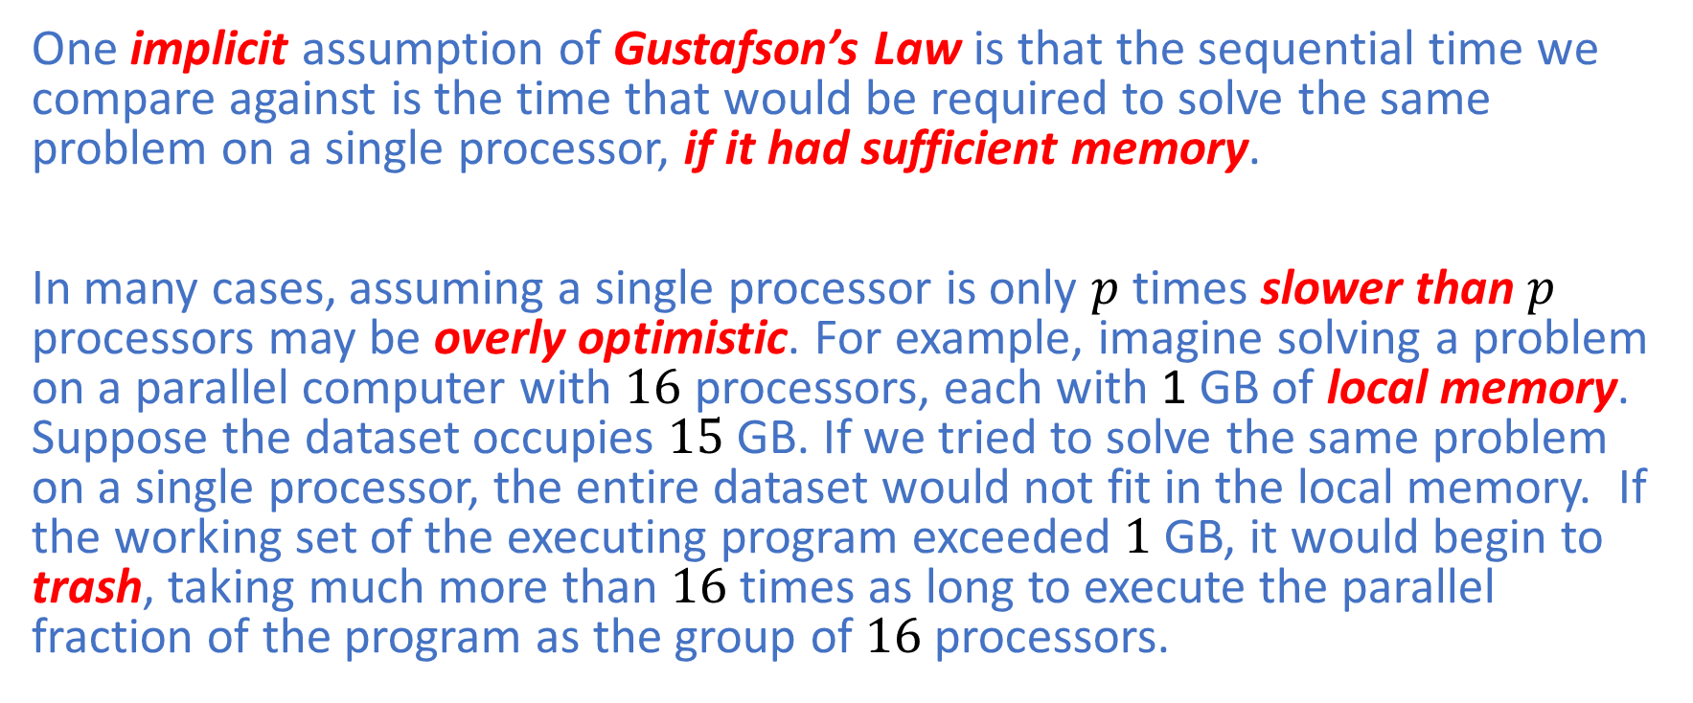
Performance Analysis: Gustafson’s Law
One implicit assumption of Gustafson’s Law is that the sequential time we compare against is the time that would be required to solve the same problem on a single processor, if it had sufficient memory.
In many cases, assuming a single processor is only $p$ times slower than $p$ processors may be overly optimistic. For example, imagine solving a problem on a parallel computer with $16$ processors, each with 1 GB of local memory. Suppose the dataset occupies $15$ GB. If we tried to solve the same problem on a single processor, the entire dataset would not fit in the local memory. If the working set of the executing program exceeded $1$ GB, it would begin to trash, taking much more than $16$ times as long to execute the parallel fraction of the program as the group of $16$ processors.

Slide 27
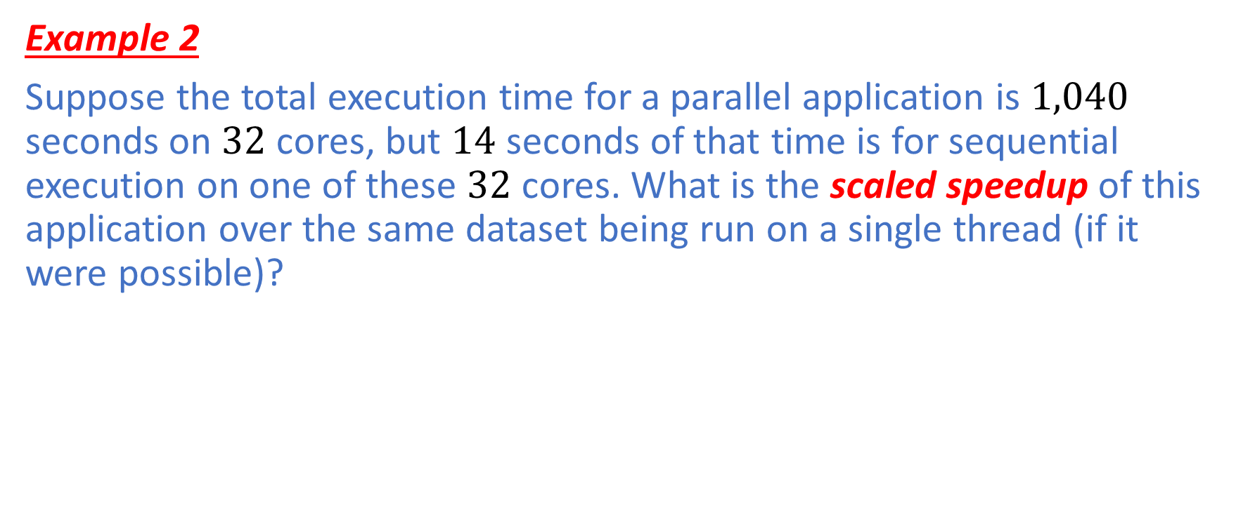
Performance Analysis: Gustafson’s Law
Example 2
Suppose the total execution time for a parallel application is $1,040$ seconds on $32$ cores, but $14$ seconds of that time is for sequential execution on one of these $32$ cores. What is the scaled speedup of this application over the same dataset being run on a single thread (if it were possible)?

Slide 28
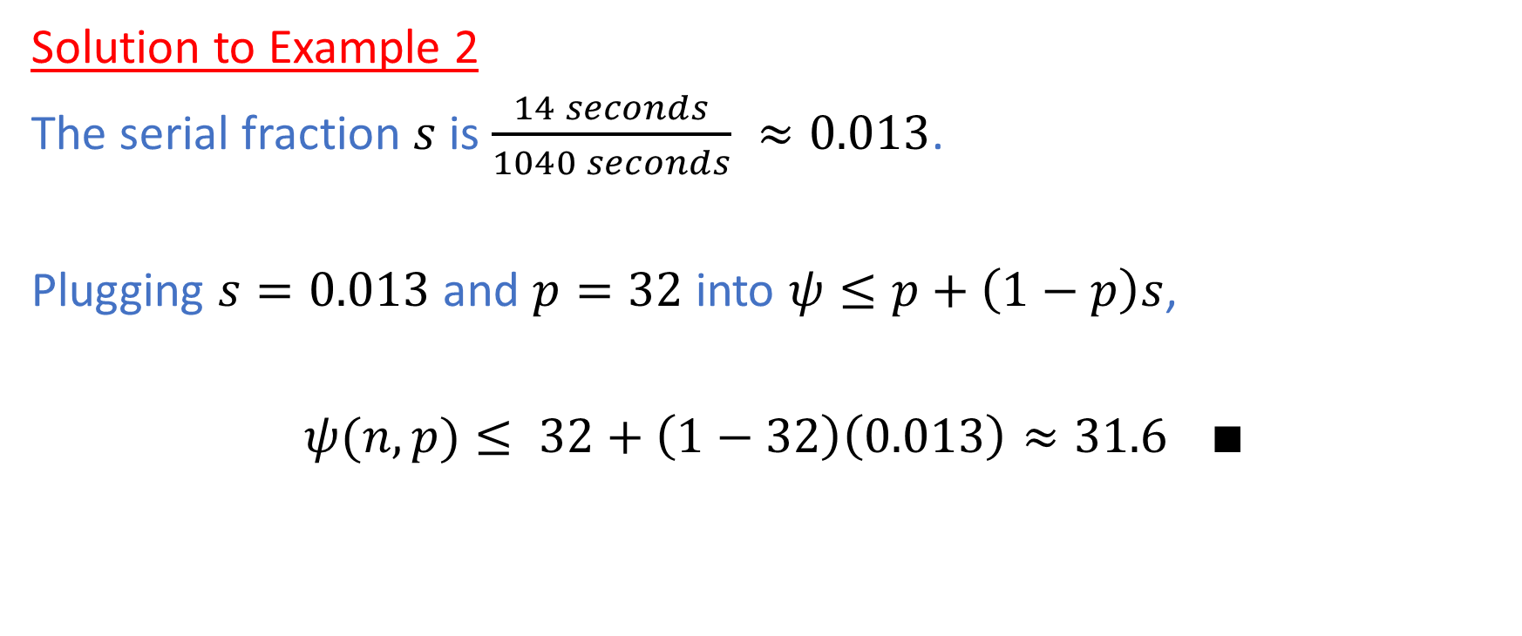
Performance Analysis: Gustafson’s Law
Solution to Example 2
The serial fraction $s$ is $\frac{14 seconds}{1040 seconds} ≈0.013$.
Plugging $s=0.013$ and $p=32$ into $ψ≤p+\left(1−p\right)s$,
$ψ(n,p)≤ 32+\left(1−32\right)\left(0.013\right)≈31.6$ $∎$

Slide 29
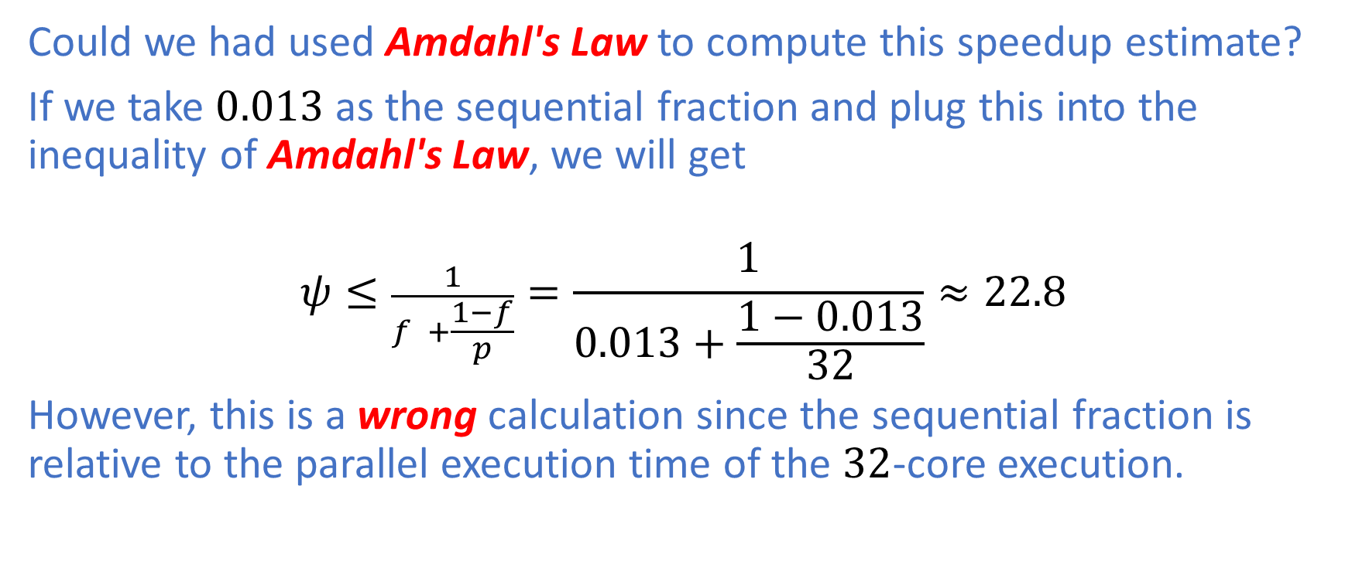
Performance Analysis: Gustafson’s Law
Could we had used Amdahl's Law to compute this speedup estimate?
If we take $0.013$ as the sequential fraction and plug this into the inequality of Amdahl's Law, we will get
$$ψ≤\frac{1}{f +\frac{1−f}{p}}=\frac{1}{0.013+\frac{1−0.013}{32}}≈22.8$$
However, this is a wrong calculation since the sequential fraction is relative to the parallel execution time of the $32$-core execution.

Slide 30
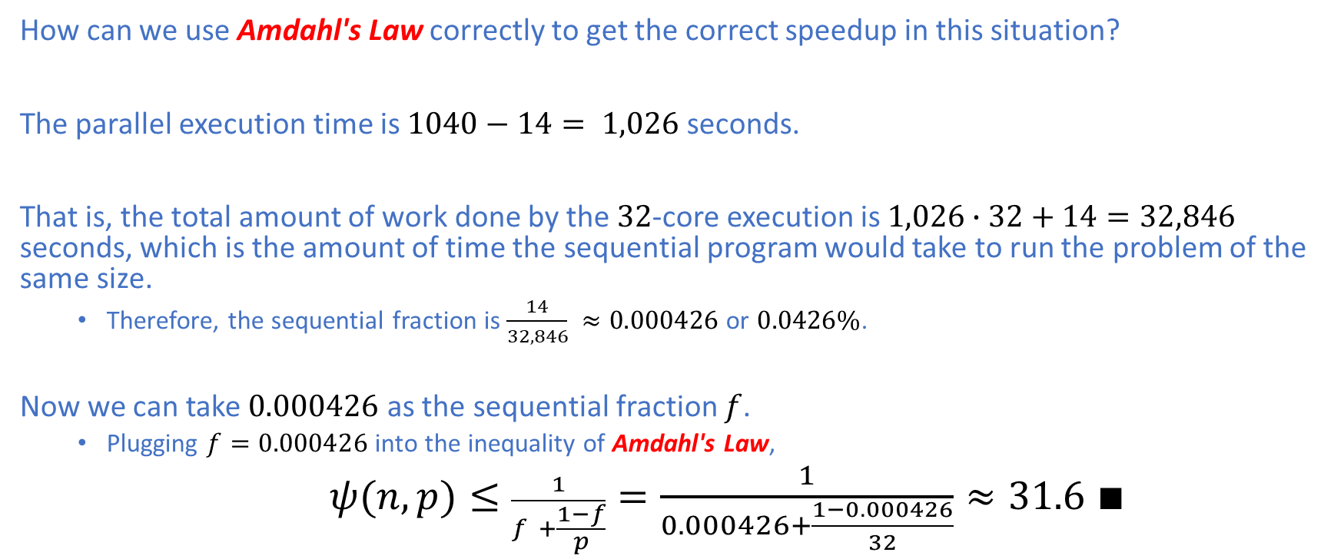
Performance Analysis: Gustafson’s Law
How can we use Amdahl's Law correctly to get the correct speedup in this situation?
The parallel execution time is $1040−14= 1,026$ seconds.
That is, the total amount of work done by the $32$-core execution is $1,026∙32+14=32,846$ seconds, which is the amount of time the sequential program would take to run the problem of the same size.
Therefore, the sequential fraction is $\frac{14}{32,846} ≈0.000426$ or $0.0426\%$.
Now we can take $0.000426$ as the sequential fraction $f$.
Plugging $f=0.000426$ into the inequality of Amdahl's Law,
$ψ(n,p)≤\frac{1}{f +\frac{1−f}{p}}=\frac{1}{0.000426+\frac{1−0.000426}{32}}≈31.6$ $∎$

Slide 31
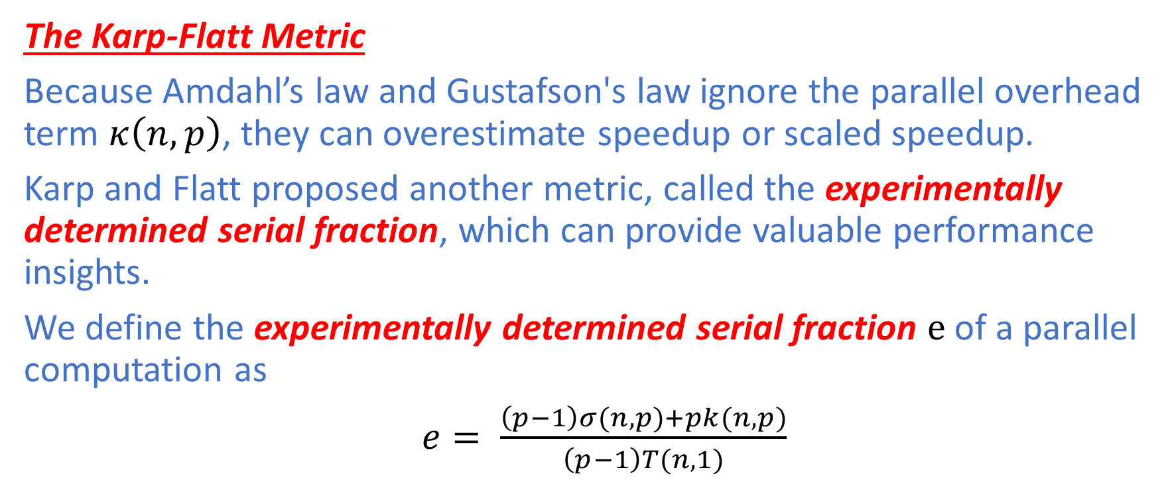
Performance Analysis: Karp-Flatt Metric
The Karp-Flatt Metric
Because Amdahl’s law and Gustafson's law ignore the parallel overhead term $κ\left(n,p\right)$, they can overestimate speedup or scaled speedup.
Karp and Flatt proposed another metric, called the experimentally determined serial fraction, which can provide valuable performance insights.
We define the experimentally determined serial fraction $e$ of a parallel computation as
$e= \frac{\left(p−1\right)σ(n,p)+pk(n,p)}{\left(p−1\right)T(n,1)}$

Slide 32

Performance Analysis: Karp-Flatt Metric
$e= \frac{\left(p−1\right)σ(n,p)+pk(n,p)}{\left(p−1\right)T(n,1)}$
Hence,
$e=p\frac{T\left(n,p\right)−T(n,1)}{\left(p−1\right)T(n,1)}$
We may now rewrite the parallel execution time as
$T\left(n,p\right)=T\left(n,1\right)e+T(n,1)(1−e)/p$
Since $ψ=T(n,1)/T(n,p)$, we have
$T\left(n,1\right)=T(n,p)ψ$.
Then,
$T\left(n,p\right)=T\left(n,p\right)ψe+T(n,p)ψ(1−e)/p$

Slide 33

Performance Analysis: Karp-Flatt Metric
Rearranging $T\left(n,p\right)=T\left(n,p\right)ψe+T(n,p)ψ(1−e)/p$,
$$e=\frac{\frac{1}{ψ}−\frac{1}{p}}{1−\frac{1}{p}}$$

Slide 34
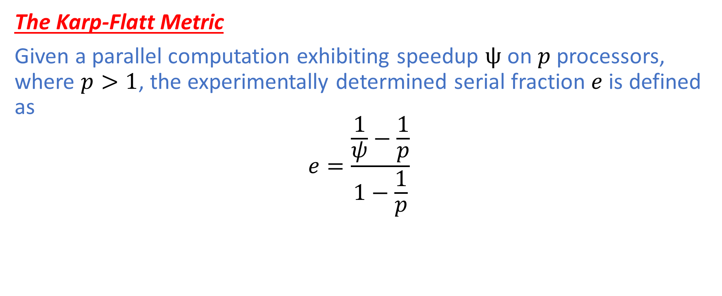
Performance Analysis: Karp-Flatt Metric
The Karp-Flatt Metric
Given a parallel computation exhibiting speedup $ψ$ on $p$ processors, where $p>1$, the experimentally determined serial fraction $e$ is defined as
$$e=\frac{\frac{1}{ψ}−\frac{1}{p}}{1−\frac{1}{p}}$$

Slide 35
Performance Analysis: Karp-Flatt Metric
The experimentally determined serial fraction is a useful metric for two reasons.
It takes into account parallel overhead that Amdahl’s law and Gustafson's law ignore
It can help us detect other sources of overhead or inefficiency that are ignored in our simple model of parallel execution time.
For a problem of fixed size, the efficiency of a parallel computation typically decreases as the number of processors increases.
By using the experimentally determined serial fraction, we can determine whether this inefficiency decrease is due to
Limited opportunities for parallelism
Increases in algorithmic or architecture overhead

Slide 36
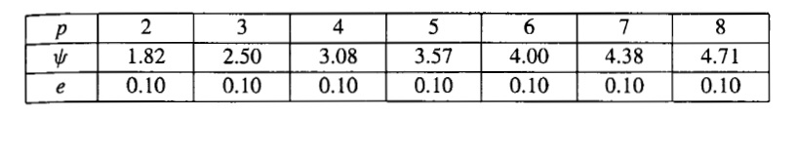
Performance Analysis: Karp-Flatt Metric
Since experimentally determined serial fraction is not increasing with the number of processors, the primary reason for the poor speedup is the limited opportunity for parallelism, that is, the large fraction of the computation that is inherently sequential.

Slide 37
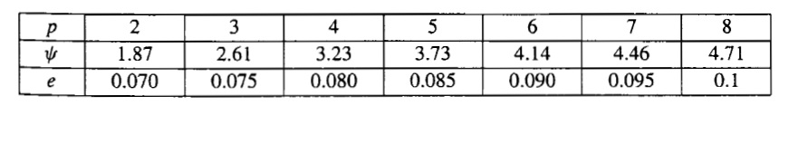
Performance Analysis: Karp-Flatt Metric
Since experimentally determined serial fraction is steadily increasing with the number of processors, the primary reason for the poor speedup is parallel overhead.

Slide 38
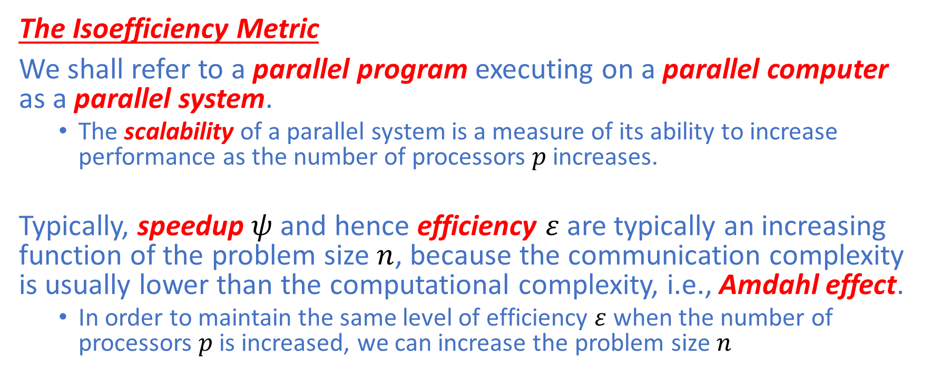
Performance Analysis: Isoefficiency
The Isoefficiency Metric
We shall refer to a parallel program executing on a parallel computer as a parallel system.
The scalability of a parallel system is a measure of its ability to increase performance as the number of processors $p$increases.
Typically, speedup $ψ$and hence efficiency $ε$ are typically an increasing function of the problem size $n$, because the communication complexity is usually lower than the computational complexity, i.e., Amdahl effect.
In order to maintain the same level of efficiency $ε$ when the number of processors $p$ is increased, we can increase the problem size $n$

Slide 39
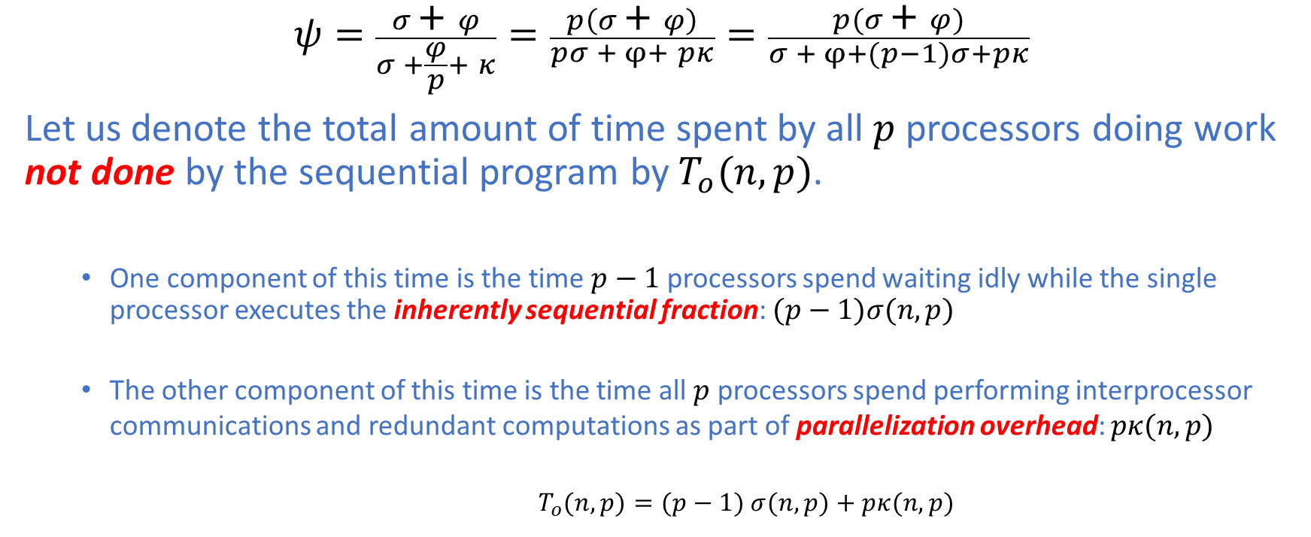
Performance Analysis: Isoefficiency
$$ψ=\frac{σ\text{ +} φ}{σ +\frac{φ}{p}+ κ}=\frac{p\left(σ\text{ +} φ\right)}{pσ + φ+ pκ}=\frac{p(σ\text{ +} φ)}{σ + φ+(p−1)σ+pκ}$$
Let us denote the total amount of time spent by all $p$processors doing work not done by the sequential program by $T_{o}(n,p)$.
One component of this time is the time $p−1$ processors spend waiting idly while the single processor executes the inherently sequential fraction: $(p−1)σ(n,p)$
The other component of this time is the time all $p$ processors spend performing interprocessor communications and redundant computations as part of parallelization overhead: $pκ(n,p)$
$T_{o}(n,p)=(p−1)$ $σ(n,p)+pκ(n,p)$

Slide 40
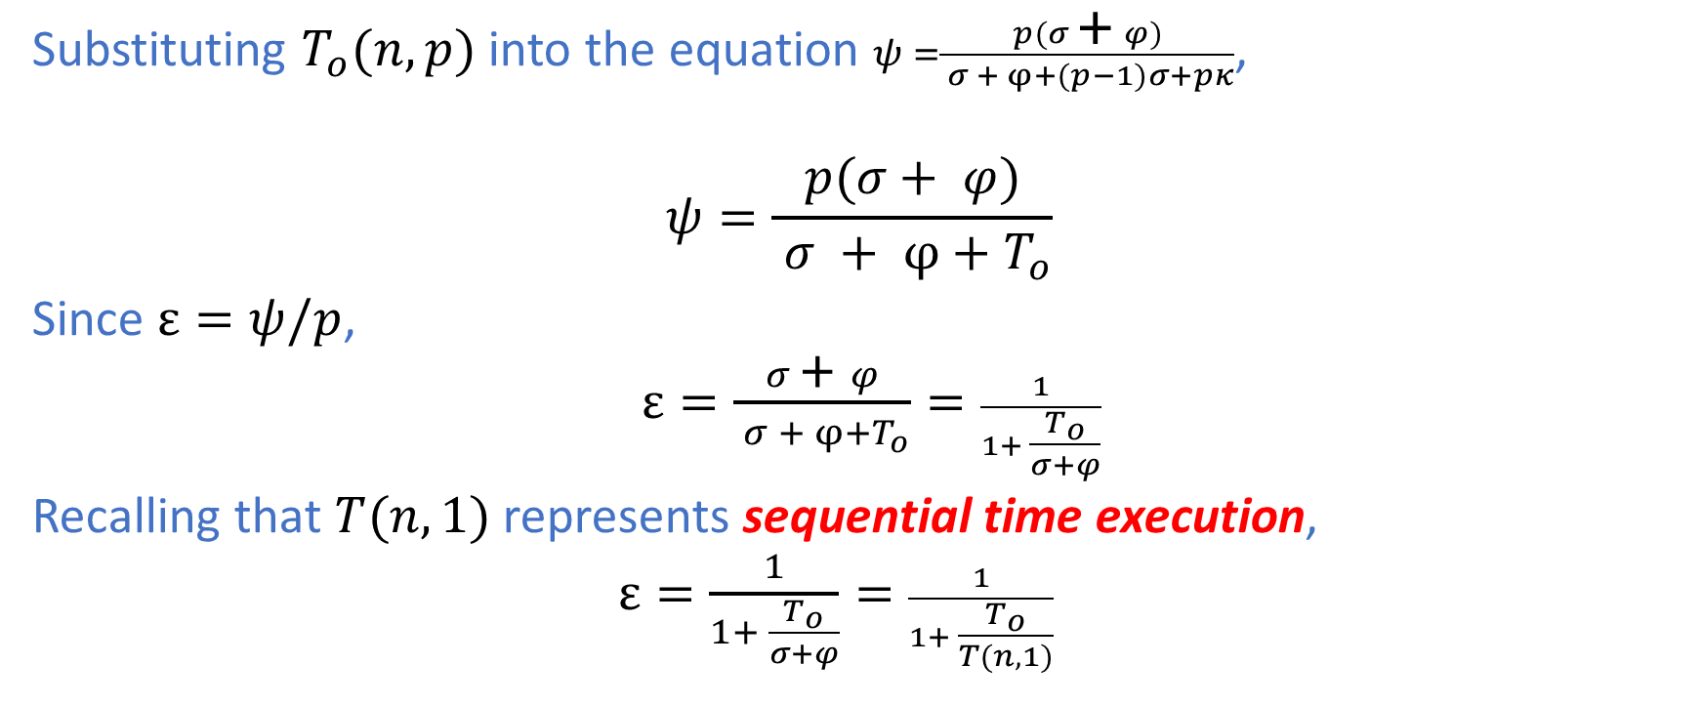
Performance Analysis: Isoefficiency
Substituting $T_{o}(n,p)$ into the equation $ψ =\frac{p(σ\text{ +} φ)}{ σ + φ+(p−1)σ+pκ}$,
$$ψ=\frac{p(σ\text{ +} φ)}{ σ + φ+T_{o}}$$
Since $ε=ψ/p$,
$ε=\frac{σ\text{ +} φ}{ σ + φ+T_{o}}=\frac{1}{1+ \frac{T_{o}}{σ+φ}}$
Recalling that $T(n,1)$ represents sequential time execution,
$ε=\frac{1}{1+ \frac{T_{o}}{σ+φ}}=\frac{1}{1+ \frac{T_{o}}{T(n,1)}}$

Slide 41
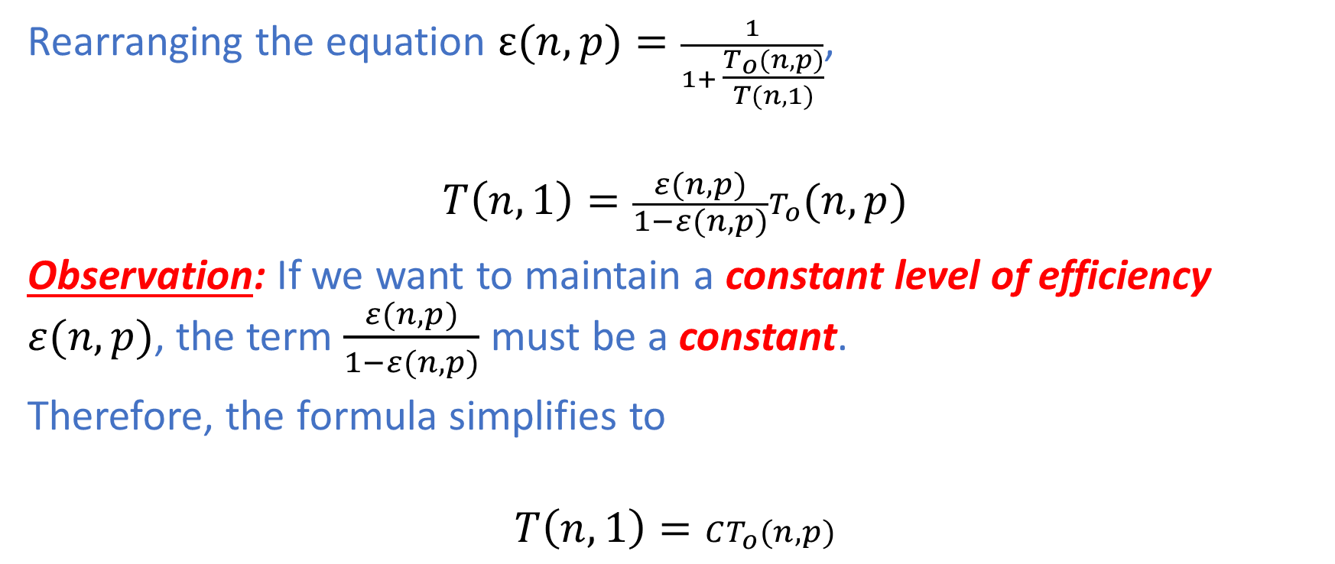
Performance Analysis: Isoefficiency
Rearranging the equation $ε(n,p)=\frac{1}{1+ \frac{T_{o}(n,p)}{T(n,1)}}$,
$$T\left(n,1\right)=\frac{ε(n,p)}{1−ε(n,p)}T_{o}(n,p)$$
Observation: If we want to maintain a constant level of efficiency $ε(n,p)$, the term $\frac{ε(n,p)}{1−ε(n,p)}$ must be a constant.
Therefore, the formula simplifies to
$$T\left(n,1\right)=CT_{o}(n,p)$$

Slide 42
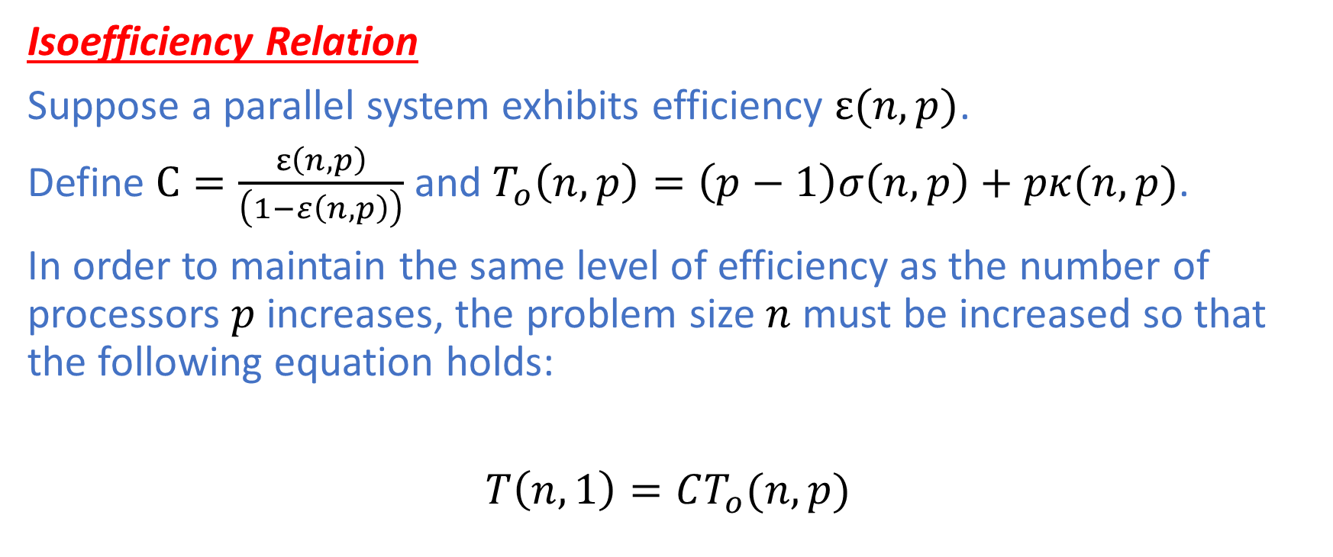
Performance Analysis: Isoefficiency
Isoefficiency Relation
Suppose a parallel system exhibits efficiency $ε(n,p)$.
Define $C=\frac{ε\left(n,p\right)}{\left(1−ε\left(n,p\right)\right)}$ and $T_{o}\left(n,p\right)=\left(p−1\right)σ\left(n,p\right)+pκ(n,p)$.
In order to maintain the same level of efficiency as the number of processors $p$ increases, the problem size $n$ must be increased so that the following equation holds:
$T\left(n,1\right)=CT_{o}(n,p)$

Slide 43
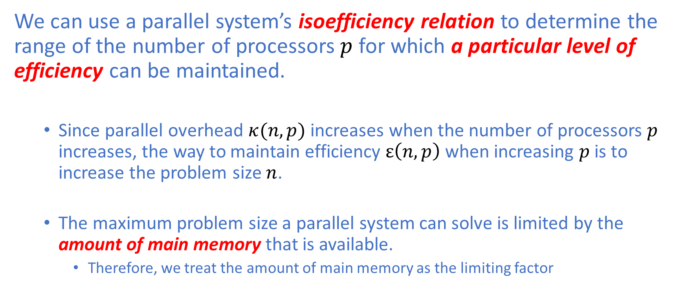
Performance Analysis: Isoefficiency
We can use a parallel system’s isoefficiency relation to determine the range of the number of processors $p$ for which a particular level of efficiency can be maintained.
Since parallel overhead $κ(n,p)$ increases when the number of processors $p$ increases, the way to maintain efficiency $ε\left(n,p\right)$ when increasing $p$ is to increase the problem size $n$.
The maximum problem size a parallel system can solve is limited by the amount of main memory that is available.
Therefore, we treat the amount of main memory as the limiting factor

Slide 44
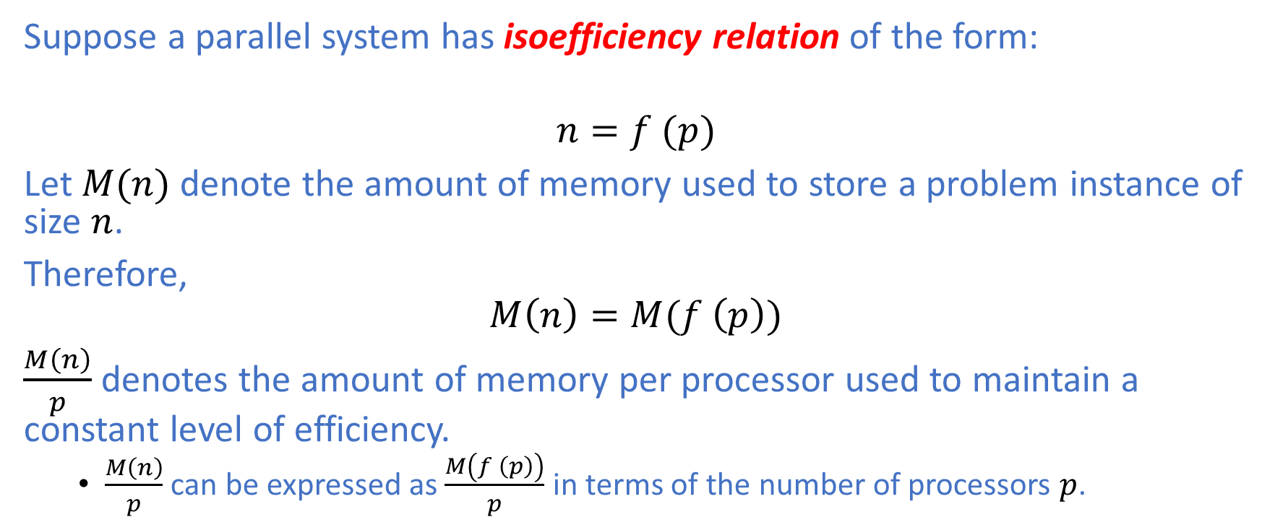
Performance Analysis: Isoefficiency
Suppose a parallel system has isoefficiency relation of the form:
$$n=f (p)$$
Let $M(n)$ denote the amount of memory used to store a problem instance of size $n$.
Therefore,
$$M\left(n\right)=M(f \left(p\right))$$
$\frac{M\left(n\right)}{p}$ denotes the amount of memory per processor used to maintain a constant level of efficiency.
$\frac{M\left(n\right)}{p}$ can be expressed as $\frac{M\left(f \left(p\right)\right)}{p}$ in terms of the number of processors $p$.

Slide 45
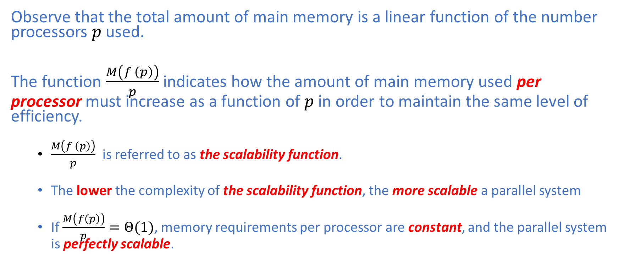
Performance Analysis: Isoefficiency
Observe that the total amount of main memory is a linear function of the number processors $p$ used.
The function $\frac{M\left(f \left(p\right)\right)}{p}$ indicates how the amount of main memory used per processor must increase as a function of $p$ in order to maintain the same level of efficiency.
$\frac{M\left(f \left(p\right)\right)}{p}$ is referred to as the scalability function.
The lower the complexity of the scalability function, the more scalable a parallel system
If $\frac{M\left(f\left(p\right)\right)}{p}=Θ(1)$, memory requirements per processor are constant, and the parallel system is perfectly scalable.

Slide 46
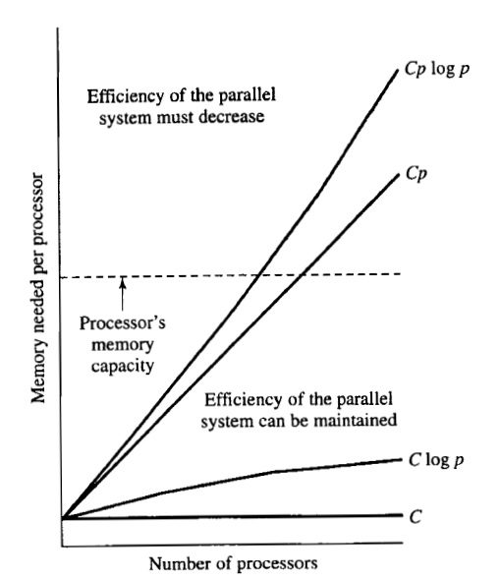
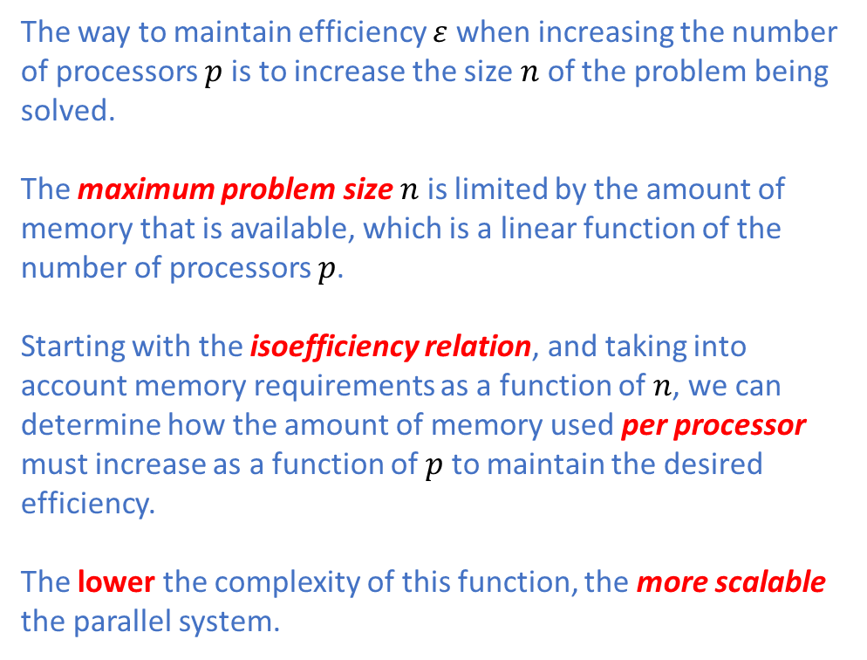
Performance Analysis: Isoefficiency
The way to maintain efficiency $ε$when increasing the number of processors $p$is to increase the size $n$ of the problem being solved.
The maximum problem size $n$ is limited by the amount of memory that is available, which is a linear function of the number of processors $p$.
Starting with the isoefficiency relation, and taking into account memory requirements as a function of $n$, we can determine how the amount of memory used per processor must increase as a function of $p$ to maintain the desired efficiency.
The lower the complexity of this function, the more scalable the parallel system.

Slide 47
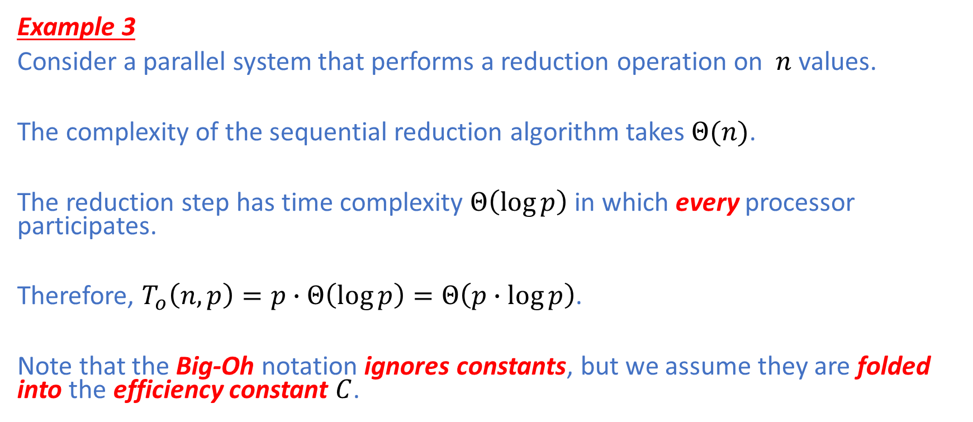
Performance Analysis: Isoefficiency
Example 3
Consider a parallel system that performs a reduction operation on $n$ values.
The complexity of the sequential reduction algorithm takes $Θ(n)$.
The reduction step has time complexity $Θ\left(\log{p}\right)$ in which every processor participates.
Therefore, $T_{o}\left(n,p\right)=p∙Θ\left(\log{p}\right)=Θ\left(p∙log{p}\right)$.
Note that the Big-Oh notation ignores constants, but we assume they are folded into the efficiency constant $C$.

Slide 48
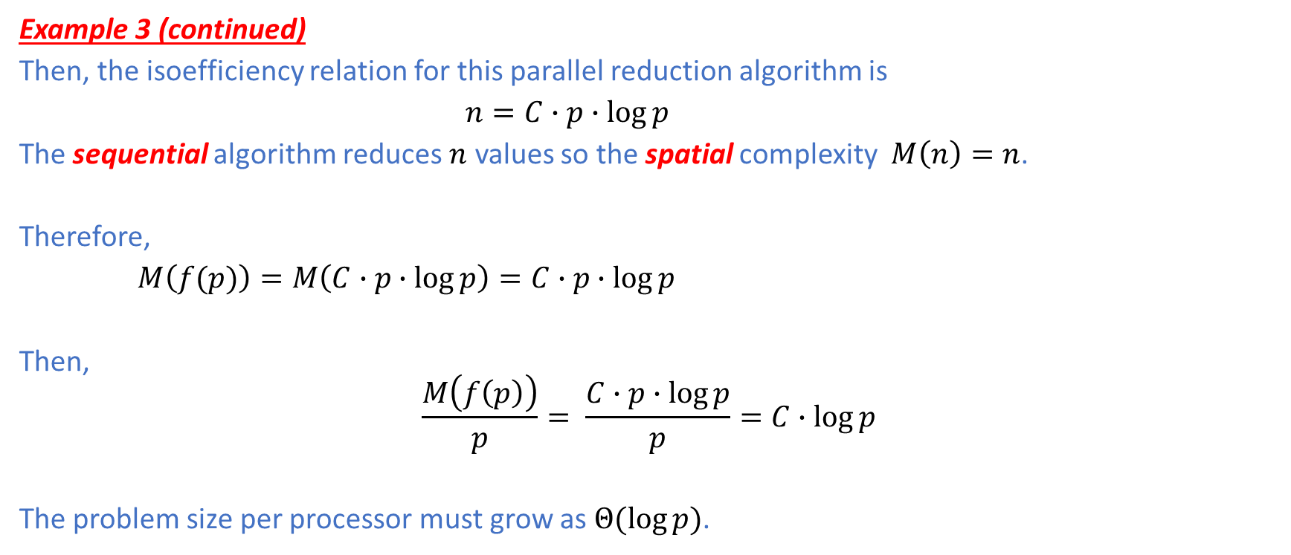
Performance Analysis: Isoefficiency
Example 3 (continued)
Then, the isoefficiency relation for this parallel reduction algorithm is
$n=C∙p∙\log{p}$
The sequential algorithm reduces $n$ values so the spatial complexity $M\left(n\right)=n$.
Therefore,
$M\left(f(p)\right)=M\left(C∙p∙\log{p}\right)=C∙p∙\log{p}$
Then,
$$\frac{M\left(f\left(p\right)\right)}{p}= \frac{C∙p∙\log{p}}{p}=C∙\log{p}$$
The problem size per processor must grow as $Θ(log{p)}$.

Slide 49
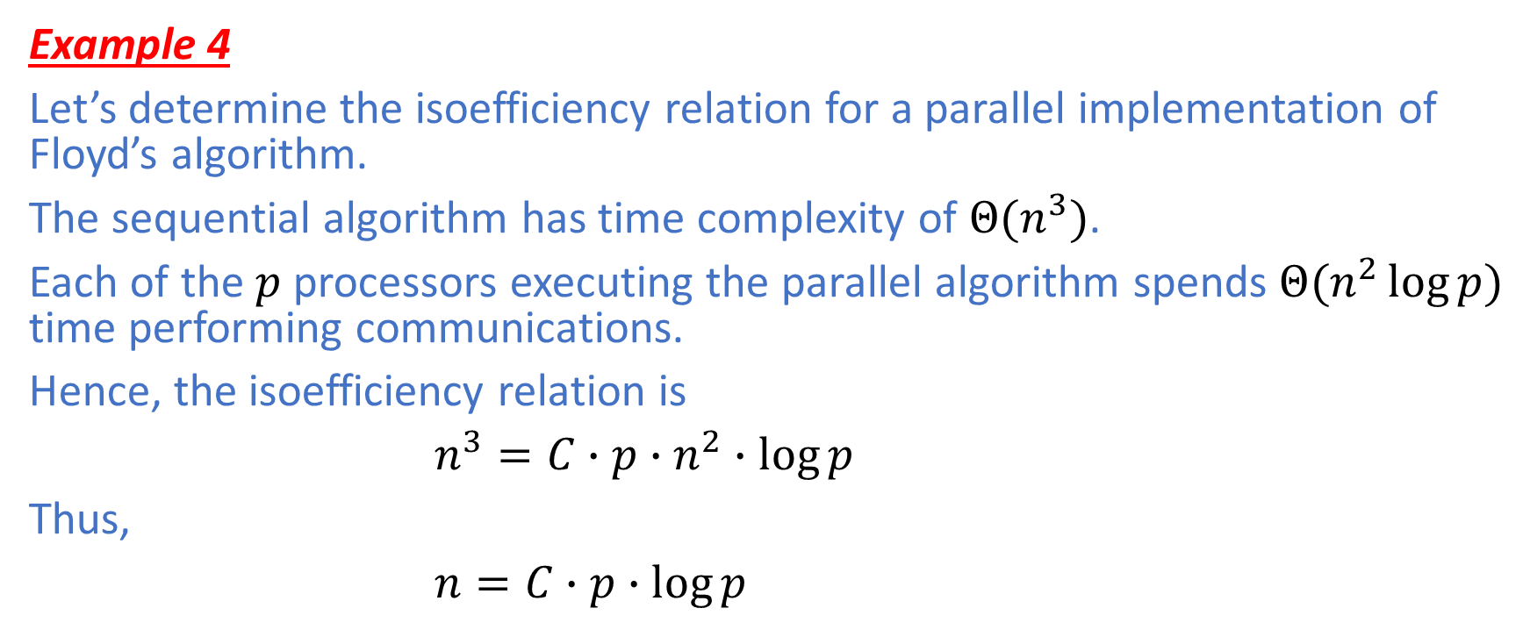
Performance Analysis: Isoefficiency
Example 4
Let’s determine the isoefficiency relation for a parallel implementation of Floyd’s algorithm.
The sequential algorithm has time complexity of $Θ(n^{3})$.
Each of the $p$processors executing the parallel algorithm spends $Θ(n^{2}\log{p})$ time performing communications.
Hence, the isoefficiency relation is
$n^{3}=C∙p∙n^{2}∙\log{p}$
Thus,
$n=C∙p∙\log{p}$

Slide 50
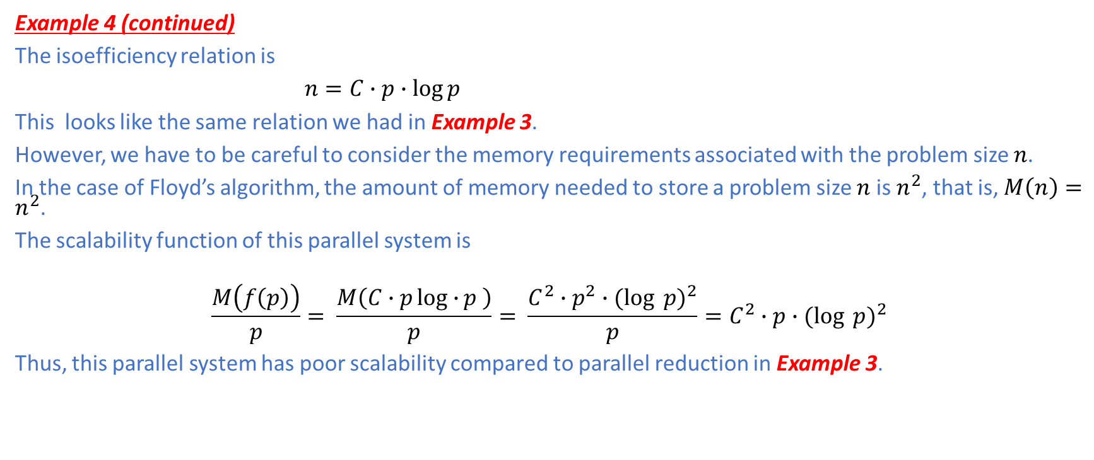
Performance Analysis: Isoefficiency
Example 4 (continued)
The isoefficiency relation is
$n=C∙p∙\log{p}$
This looks like the same relation we had in Example 3.
However, we have to be careful to consider the memory requirements associated with the problem size $n$.
In the case of Floyd’s algorithm, the amount of memory needed to store a problem size $n$ is $n^{2}$, that is, $M\left(n\right)=n^{2}$.
The scalability function of this parallel system is
$$\frac{M\left(f\left(p\right)\right)}{p}= \frac{M\left(C∙plog∙{p} \right)}{p}= \frac{C^{2}∙p^{2}∙{(log{p)}}^{2}}{p}=C^{2}∙p∙{(log{p)}}^{2}$$
Thus, this parallel system has poor scalability compared to parallel reduction in Example 3.

Slide 51
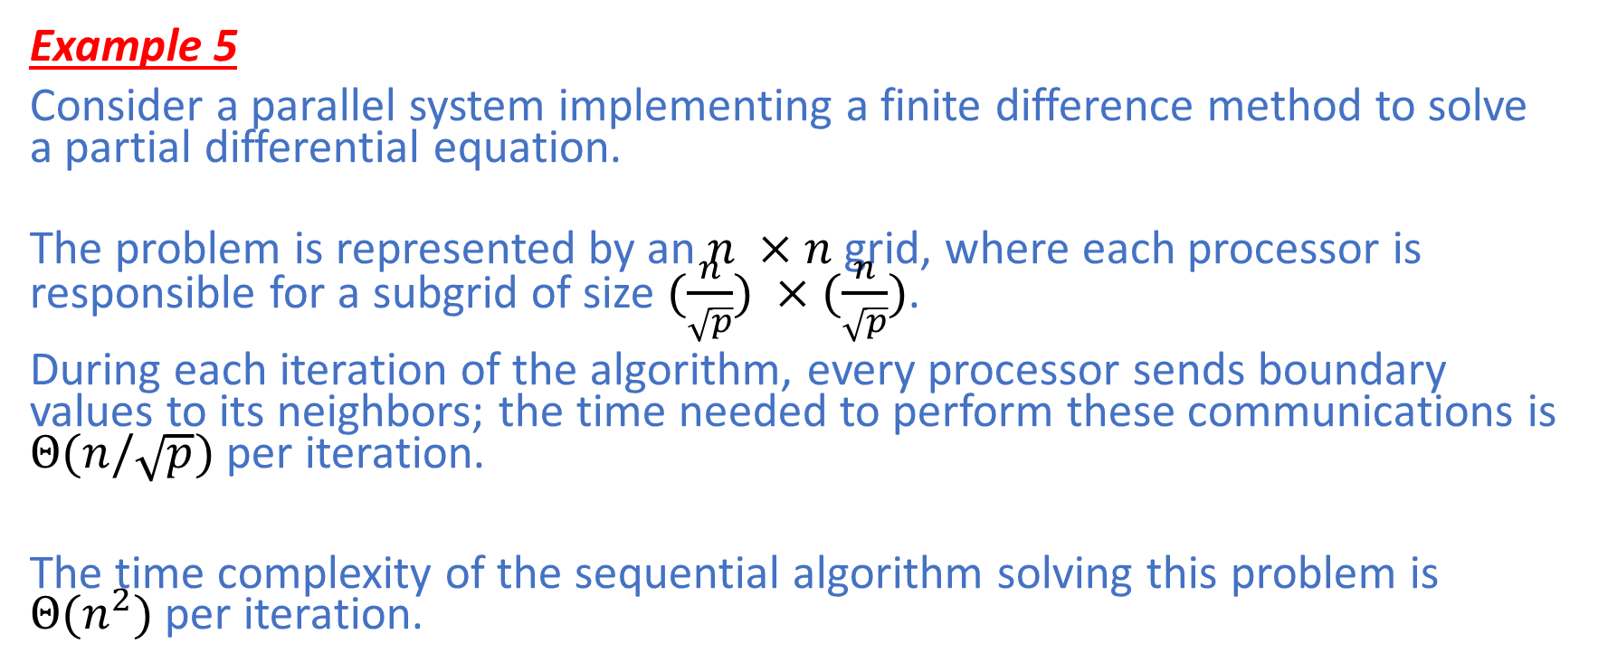
Performance Analysis: Isoefficiency
Example 5
Consider a parallel system implementing a finite difference method to solve a partial differential equation.
The problem is represented by an $n ×n$ grid, where each processor is responsible for a subgrid of size $(\frac{n}{\sqrt{p}}) ×(\frac{n}{\sqrt{p}})$.
During each iteration of the algorithm, every processor sends boundary values to its neighbors; the time needed to perform these communications is $Θ(n/\sqrt{p})$ per iteration.
The time complexity of the sequential algorithm solving this problem is $Θ(n^{2})$ per iteration.

Slide 52

Performance Analysis: Isoefficiency

Slide 53

Performance Analysis: Isoefficiency
Example 5 (continued)
The isoefficiency relation for this parallel system is
$n^{2}=C∙p∙ \frac{n}{\sqrt{p}}$
Thus, $n=C∙ \sqrt{p}$
A problem instance has size $n$ so the grid contains $n^{2}$ elements.
Therefore, $M\left(n\right)=n^{2}$.
$\frac{M\left(f\left(p\right)\right)}{p}= \frac{M(C∙\sqrt{p})}{p}= \frac{C^{2}∙p}{p}=C^{2}$
The scalability function is $Θ(1)$, meaning that the parallel system is perfectly scalable.

Slide 54
Reference
Michael J. Quinn. 2003. Parallel Programming in C with MPI and OpenMP. McGraw-Hill Education Group.

